Slide 1
Teaching Next Generation Science Standards with the EEI Curriculum
We’ll help you get ready for NGSS!

Slide 2
Laura Walls, EEI Teacher Ambassador
Teaching Next Generation Science Standards with the EEI Curriculum
Kirk Amato, Environmental Education Specialist
Kirk Amato, Environmental Education Specialist

Slide 3
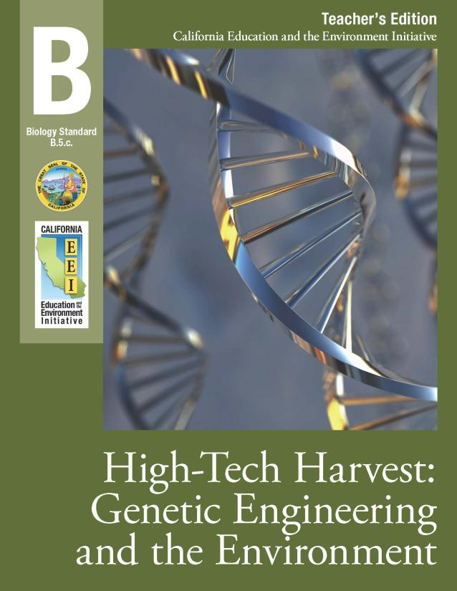
modern relevant engaging
California Education and the Environment Curriculum
Written for the 21st Century

Slide 4
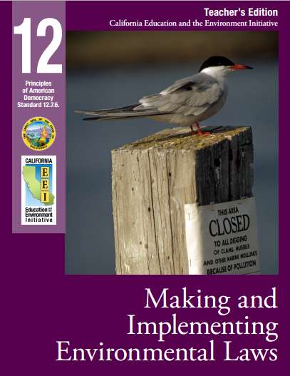
Promotes Civic Responsibility
California Education and the Environment Curriculum
Challenging Informational Text

Slide 5
NGSS and EEI Environmental Principles
PRINCIPLE I
People Depend
On Natural
Systems
PRINCIPLE II People Influence
Natural Systems
PRINCIPLE III
Natural Systems
Change in Ways
That People Benefit
From and Can
Influence
PRINCIPLE IV
There are no Permanent
or Impermeable Boundaries
that Prevent Matter
from Flowing Between
Systems
PRINCIPLE V
Decisions Affecting
Resources and Natural
Systems are Complex
and Involve Many
Factors
Notes:
The EEI is based on a handful of key environmental principles that the State Board of Education has affirmed as fundamental to the education we want all California students to receive. These speak directly to the deep sense of connectedness and interdependence that come with the overview effect and that are embodied in John Muir’s famous quote: "When we try to pick out anything by itself, we find it hitched to everything else in the Universe."

Slide 6
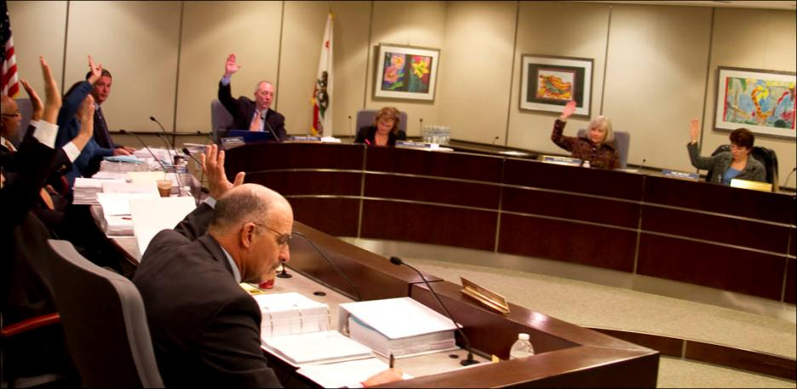
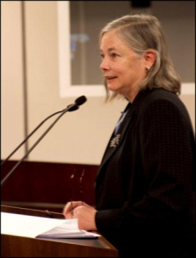
Development of EEI Curriculum
State Board of Education
Senator
Fran Pavley

Slide 7
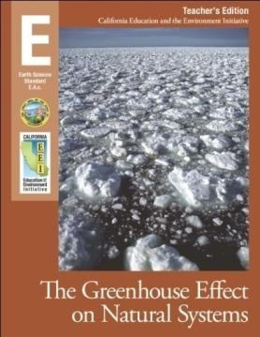
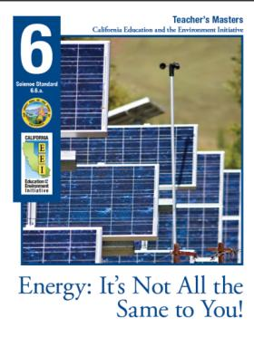
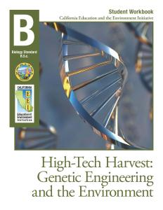
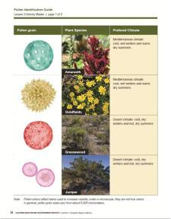
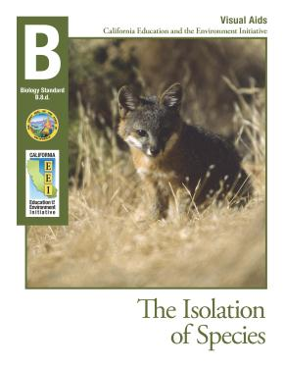
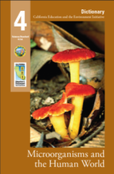
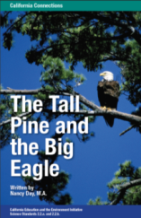
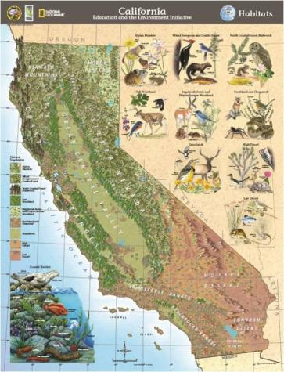
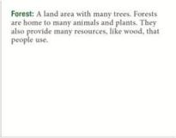
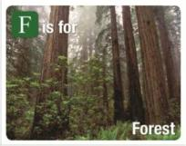
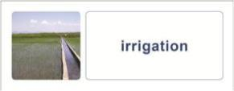
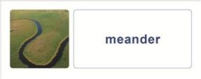
Information Cards
Student Workbook
Teacher’s Edition
Teacher’s Masters
Visual Aids
Sample K-12 Curriculum Components
Dictionary
Reader
Big Book
Word Wall Cards
Vocabulary & Alphabet Cards
NGS Wall Map
Notes:
Darker Green Font and change color of black text. Many of the units have form fillable .pdfs for paperless classrooms, promote digital literacy and conservation. Like textbook publishers, there are a variety of materials for effective classroom teaching.
Each Curriculum Unit has a Teacher’s Edition,
Teacher’s Masters and Student Workbooks.
Depending on the grade, there are vocabulary and alphabet cards, word wall cards, Big Books (carpet time), student editions - and beautiful large wall maps created in partnership with NGS.

Slide 8
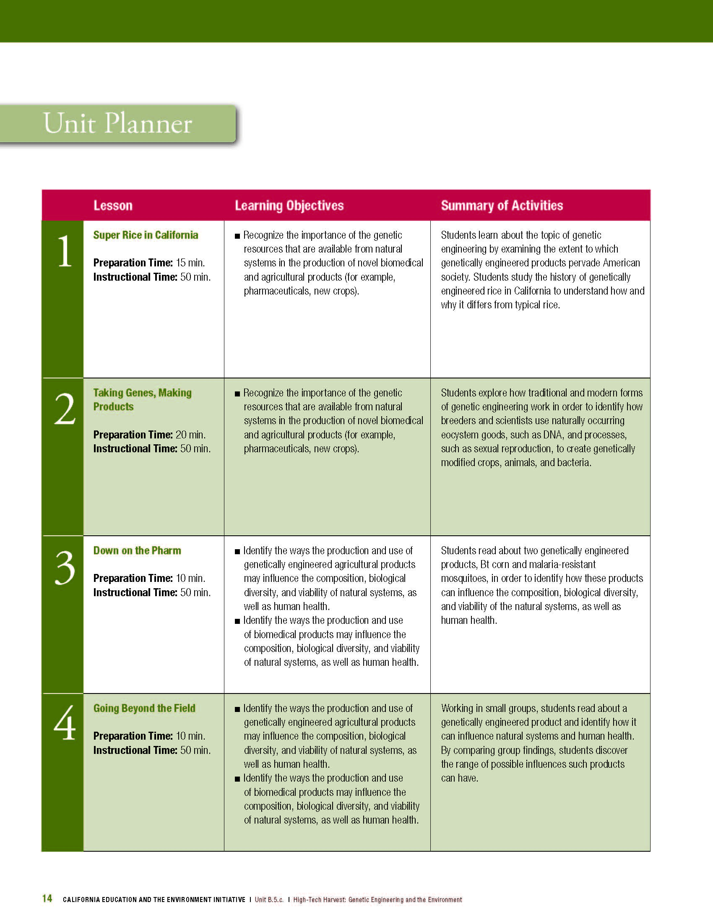
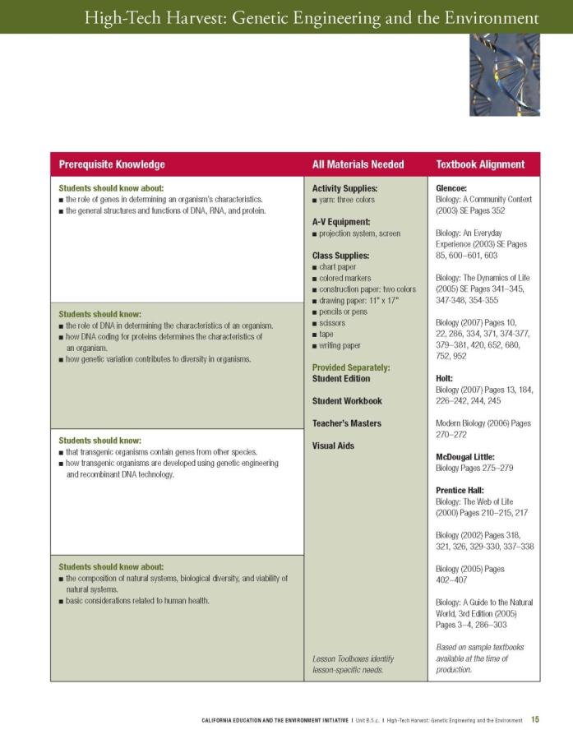
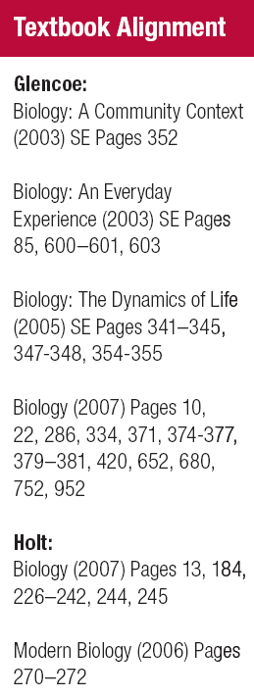
Deliver Your Presentation
Replace adopted textbook sections with up to date, relevant curriculum
3
Notes:
Replacement strategy saves prep time…enhances student interest by piquing their interest.

Slide 9
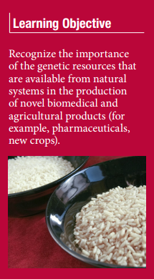
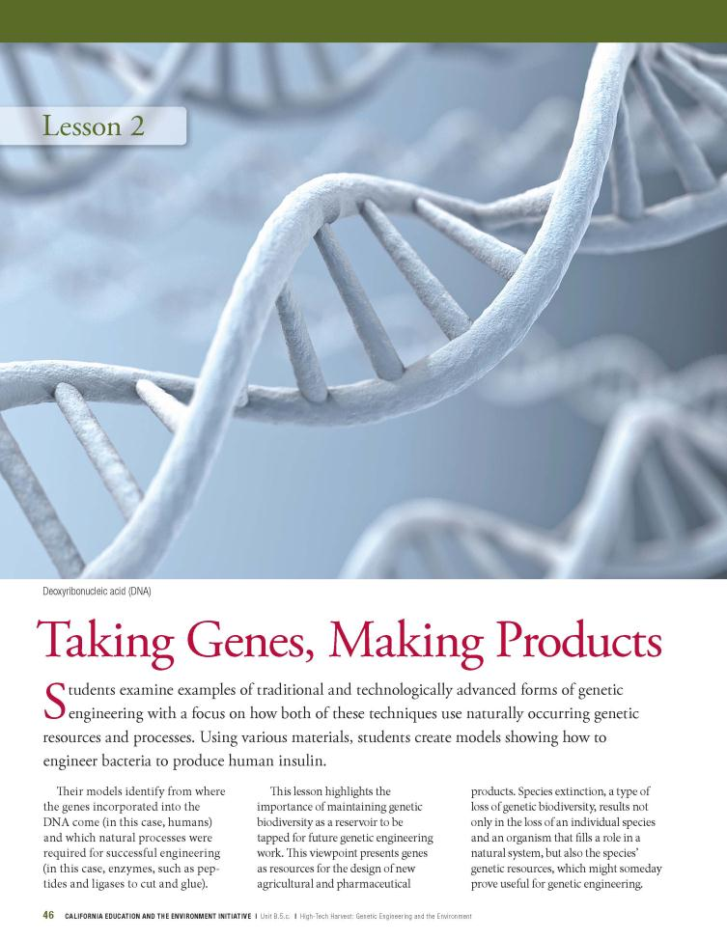
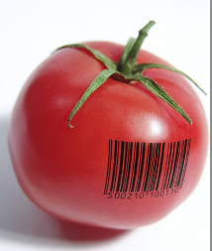
EEI Curriculum includes the tools you need.
Notes:
Domain specific vocabulary
21st Century College and Career-Ready Skills and Vocabulary

Slide 10
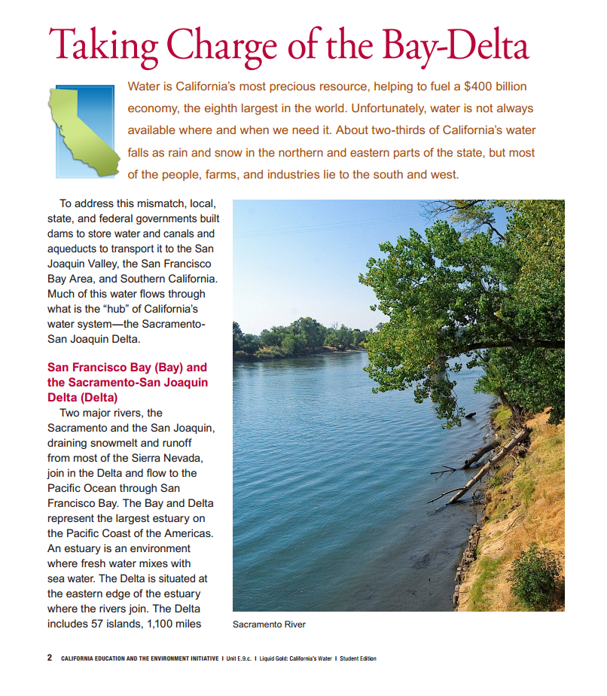
Specifically designed for California
Rich Informational Text
Notes:
Engaging topics

Slide 11
NGSS Basics
Emphasis on depth over breadth
Blending of content and practice
Focus on Cross-cutting concepts

Slide 12
Ready!
http://www.teachtci.com/science/interactive-science-textbooks-and-curriculum/understanding-ngss.html
Notes:
Cross Cutting Relationships are addressed throughout the units in every grade levels

Slide 13
The Shift in Emphasis

Slide 14
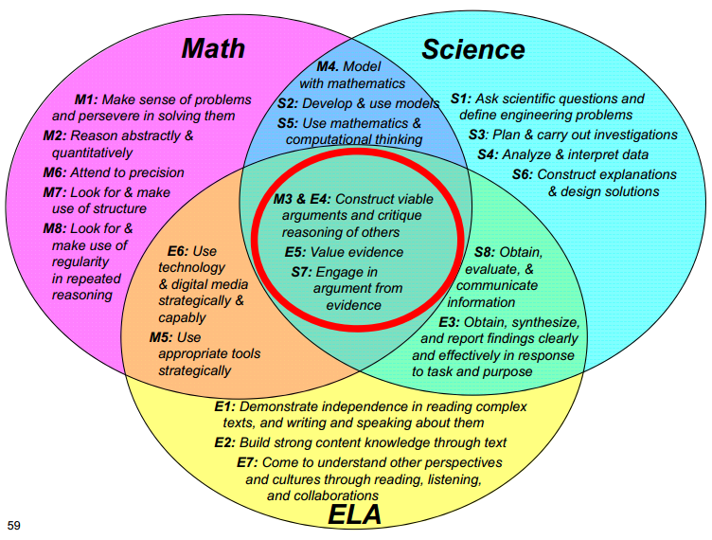
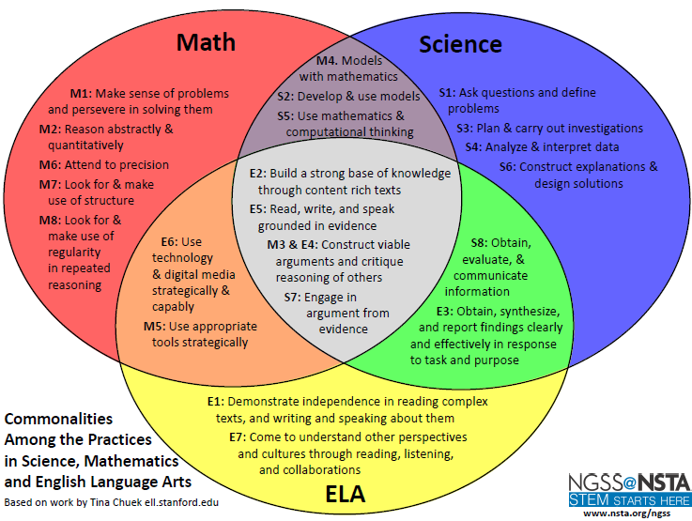
NGSS Works with Common Core
Notes:
http://learningcenter.nsta.org/products/symposia_seminars/Ngss/files/ConnectionsBetweenPracticesinNGSSCommonCoreMathandCommonCoreELA_2-12-2013.pdf

Slide 15
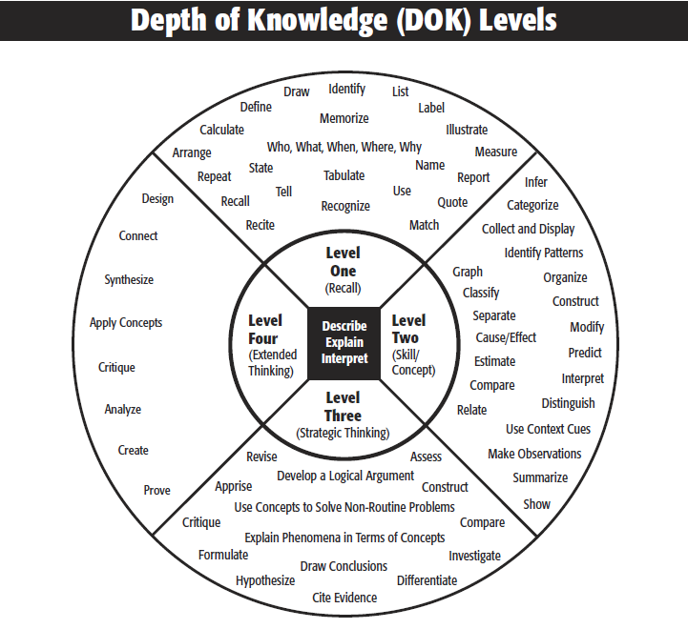
Webb’s DOK

Slide 16
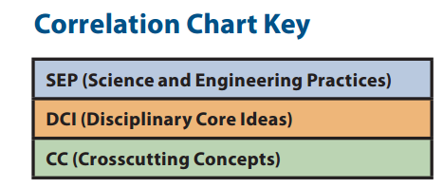
NGSS Correlations

Slide 17
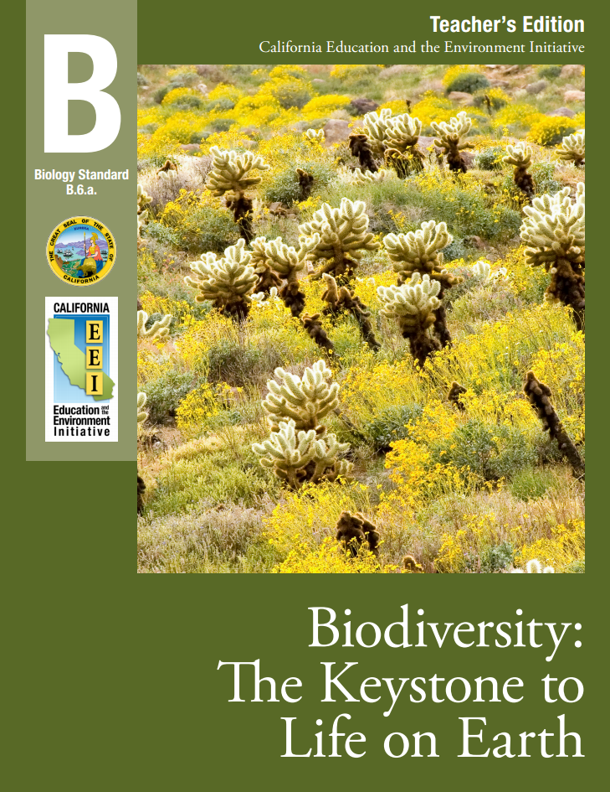
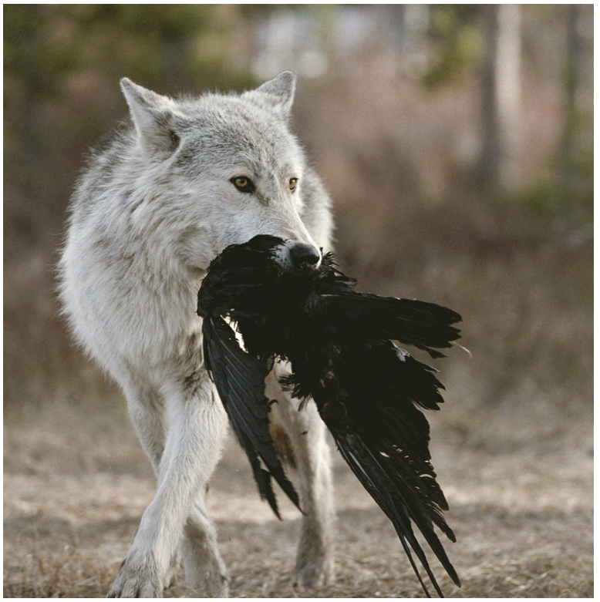
Biodiversity: The Keystone to Life on Earth - Lesson 5

Slide 18
Biodiversity: The Keystone to Life on Earth - Lesson 5
What do you think happened to the ecosystem when the wolves were reintroduced into Yellowstone?
I’m the top predator!
What is a keystone species?

Slide 19
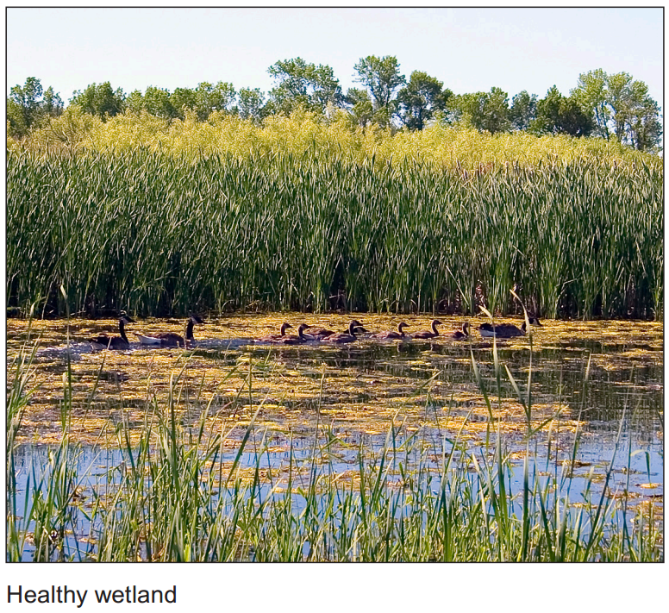
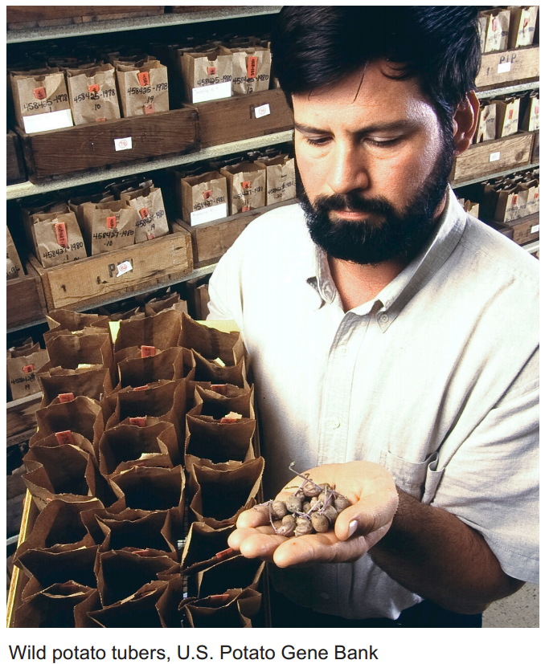
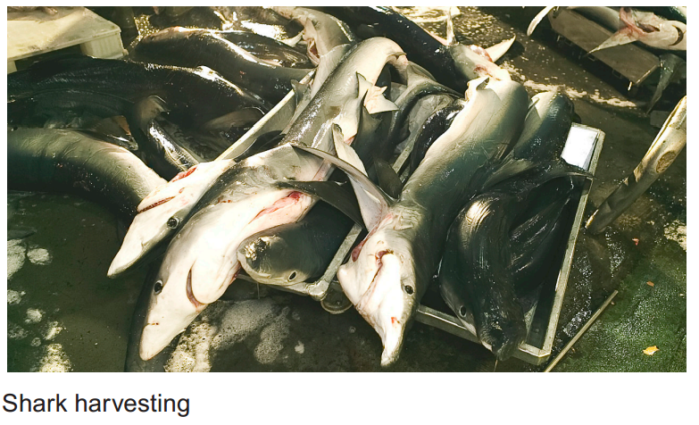
Biodiversity: The Keystone to Life on Earth - Lesson 5
How could the loss of species in your bioregion affect you and your community?

Slide 20
HS-LS2.C: Ecosystem Dynamics, Functioning and Resilience
HS-LS4.D: Biodiversity
HS-ESS3.C: Human Impacts on Earth’s Systems
Disciplinary Core Ideas
Notes:
Icons: http://concord.org/ngss/

Slide 21
Science and Engineering Practices
Use the information about the loss of a keystone species as the basis for a discussion of the effects of species loss in their local bioregion.
Crosscutting Concepts
Using information about the wolf population in Yellowstone National Park, students identify the causal relationship between changes to the overall ecosystem and the loss of a keystone species.

Slide 22
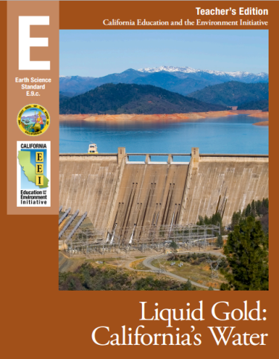
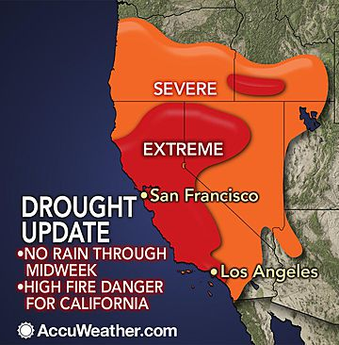
Liquid Gold: California’s Water - Lesson 3

Slide 23
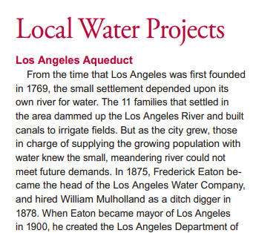
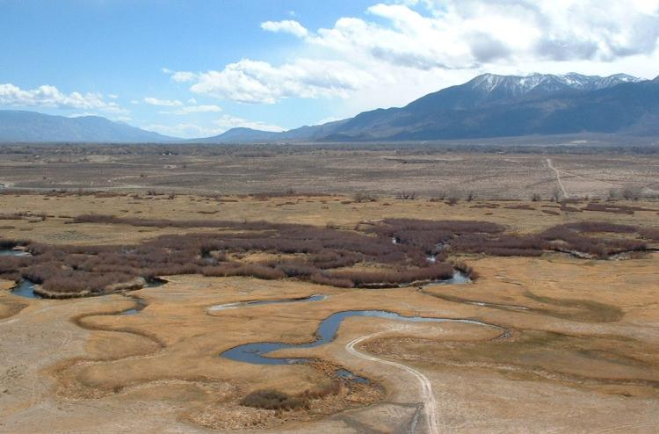
How do humans change the planet?
Owen’s Valley

Slide 24
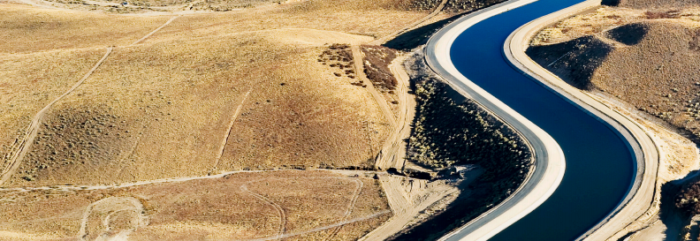
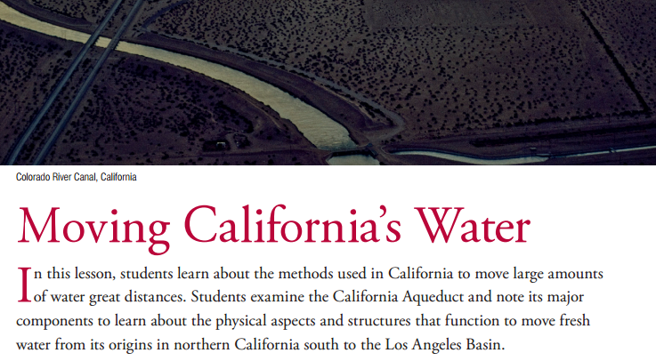
Lesson 3: Moving California’s Water
Notes:
Add Common Core Standard Box

Slide 25
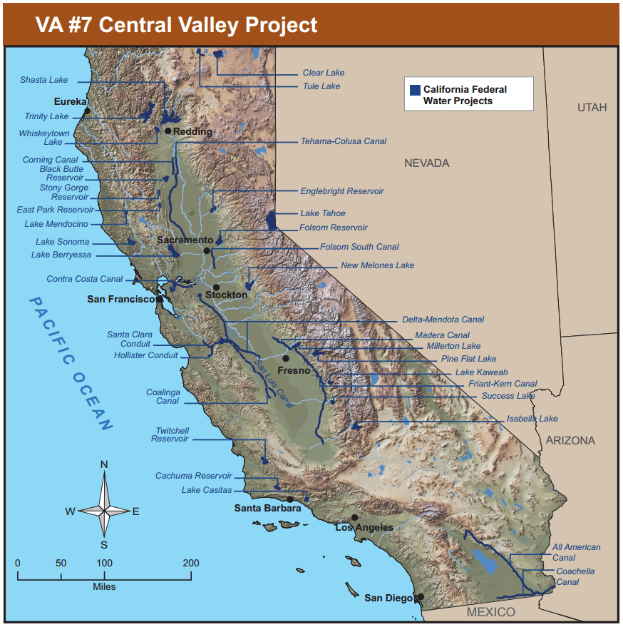
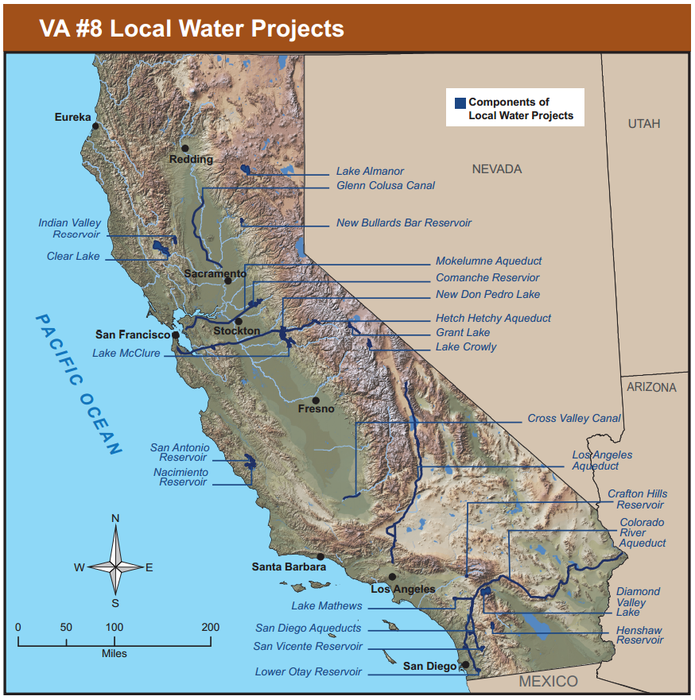
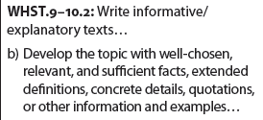
Lesson 3: Moving California’s Water
How does your water project serve the needs of all Californians?

Slide 26
HS-ESS3.A : Natural Resources
Resource availability has guided the development of human society (HS-ESS3-1)
All forms of . . . resource extraction have costs, risks and benefits (HS-ESS3-2)
HS-ESS3.C: Human Impacts on Earth Systems
Disciplinary Core Ideas
Notes:
Icons: http://concord.org/ngss/

Slide 27
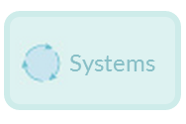
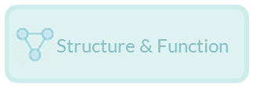
Science and Engineering Practices
Defining an engineering problem
Developing possible solutions
Crosscutting Concepts
Links Among Engineering, Technology, Science, and Society
Influence of engineering, technology, and science on society and the natural world
Notes:
Icons: http://concord.org/ngss/

Slide 28
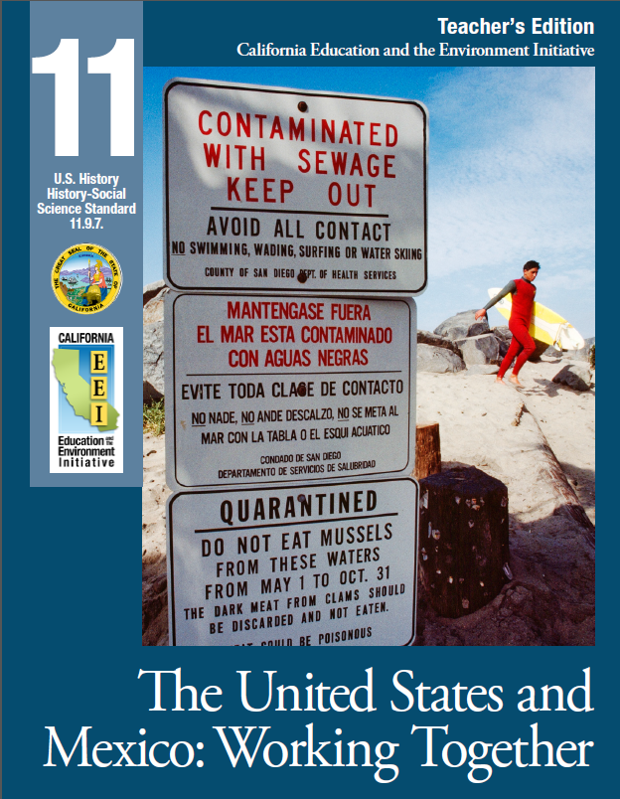
Lesson 4: From a Different Perspective

Slide 29
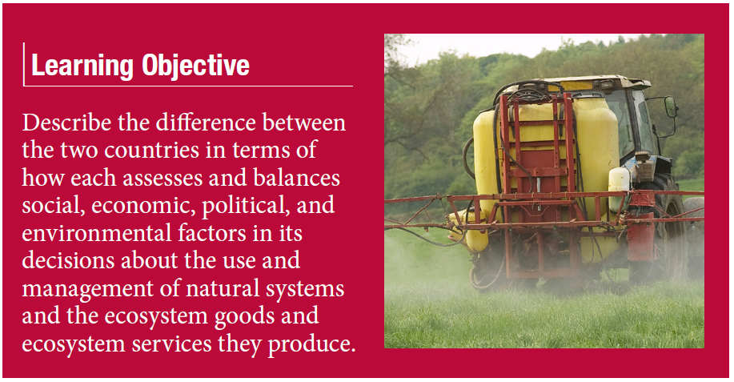
Lesson 4: From a Different Perspective

Slide 30
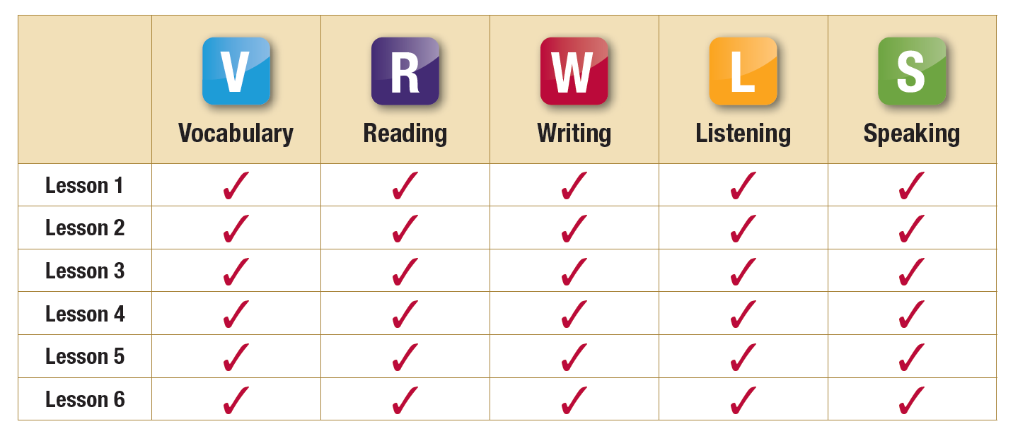
Support English Language Learners with daily practice using Academic Vocabulary, Reading, Writing, Listening and Speaking

Slide 31
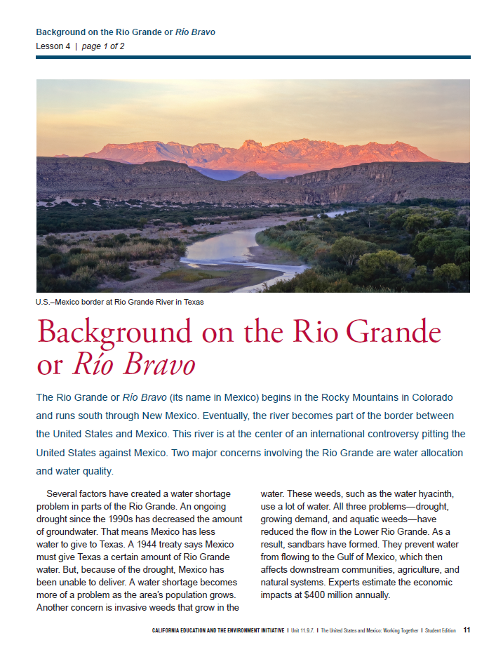
Lesson 4: From a Different Perspective
Students build background knowledge about the Rio Grande watershed and discuss issues of water quantity and water quality.
1944 Treaty
Water Quantity vs.
Water Quality

Slide 32
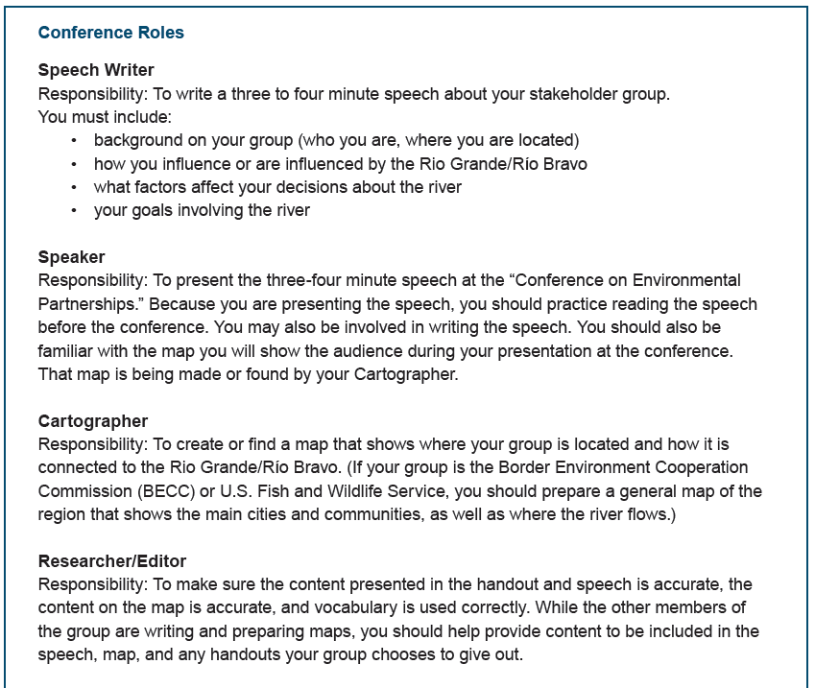
Lesson 4: From a Different Perspective

Slide 33
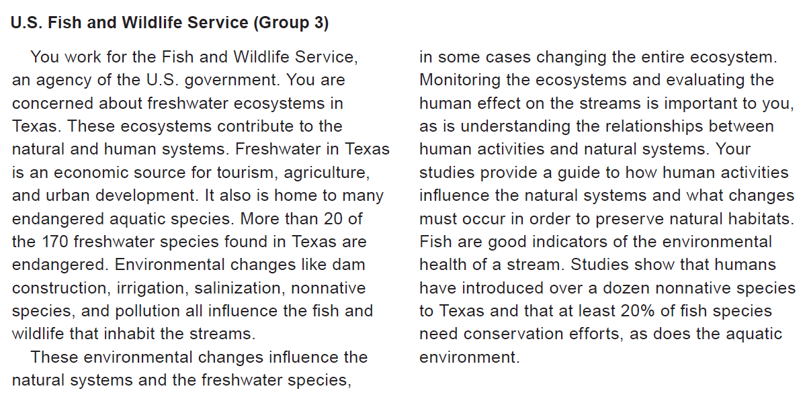
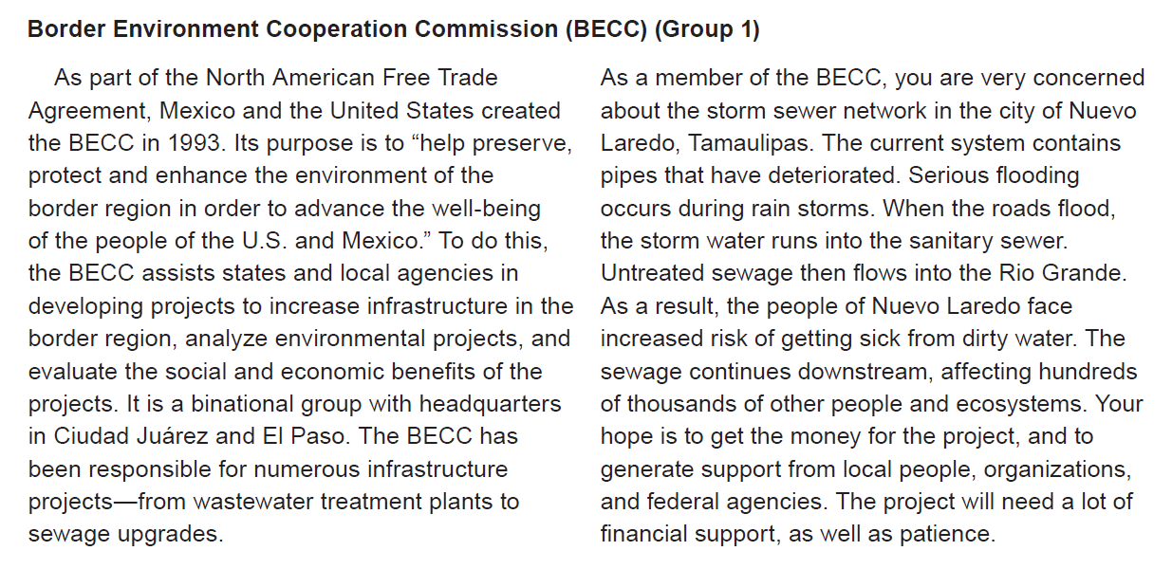
Lesson 4: Session 2

Slide 34
Lesson 4: Session 2
Students work collaboratively to prepare for the simulated “Conference on Environmental Partnerships between the United States and Mexico.”

Slide 35
Lesson 4: Conference Conclusion
Students synthesize evidence from diverse perspectives Webb’s DOK Level 4: Extended Thinking
Whole Group Discussion Questions
Why are the environmental issues surrounding the Rio Grande so complicated?
How can stakeholders balance everyone’s social, economic and political concerns when dealing with environmental issues?

Slide 36
Opportunities for Implementation
Free Teacher and Student Materials
Free On-Site Professional Development
Free Teachers’ Webinar Training
CEUs for EEI Training
EEI Workshops offered on site
Notes:
Change header title

Slide 37
EEI Educating for the Future
“Can school always be this way?
I feel like I’m learning important stuff for my life.” Sixth Grade Student

Slide 40
www.CaliforniaEEI.org
Notes:
OK – this wraps up my part of the presentation …
Now David Whitman will show share some example lessons

